Slide 1

CHAPTER 6: ADVANCED SQL PART A: JOIN
Modern Database Management

Slide 2
Objectives
Define terms
Write single and multiple table SQL queries
Define and use three types of joins

Slide 3
Processing Multiple Tables – JOIN
Join – A relational operation that causes two or more tables with a common domain to be combined into a single table or view
Equi-join – A join in which the joining condition is based on equality between values in the common columns (common columns appear redundantly in the result table)
Natural join – An equi-join in which one of the duplicate columns is eliminated in the result table
The common columns in joined tables are usually the primary key of the dominant table and the foreign key of the dependent table in 1:M relationships

Slide 4
Processing Multiple Tables – JOIN (Cont.)
Outer join – A join in which rows that do not have matching values in common columns are nonetheless included in the result table
As opposed to inner join, in which rows must have matching values in order to appear in the result table
Union join – Including all columns from each table in the join, and an instance for each row of each table
Self join – Matching rows of a table with other rows from the same table

Slide 5
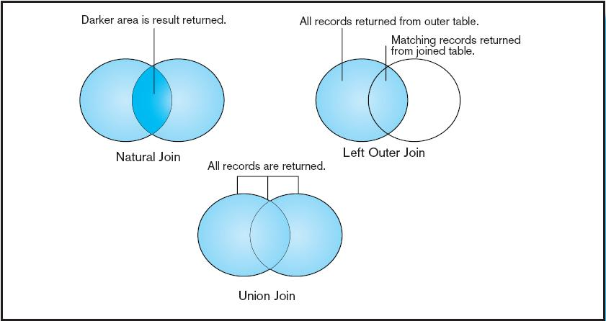
Figure 6-2: Visualization of different join types with results returned in shaded area

Slide 6
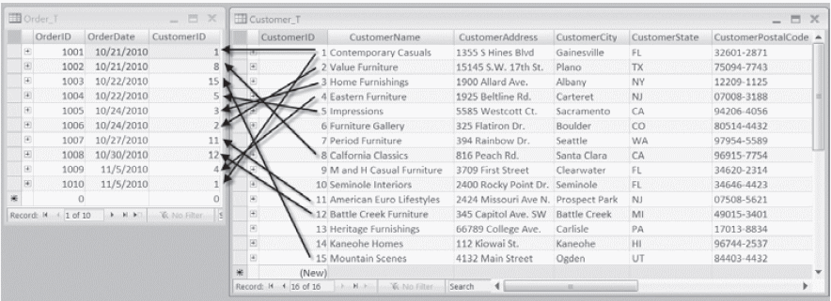
Figure 6-1: Pine Valley Furniture Company Customer_T and Order_T tables
These tables are used in queries in following slides.

Slide 7
Equi-Join Example
Q1.1: For each customer who placed an order, what is the customer’s name and OrderID?
SELECT Customer_T.CustomerID, CustomerName, OrderID
FROM Customer_T, Order_T
WHERE Customer_T.CustomerID=Order_T.CustomerID
ORDER BY OrderID;
Why the difference?
Equi-Join

Slide 8
INNER Join Example
Q 1.2 For each customer who placed an order, what is the customer’s name and order number?
The result of this INNER JOIN is the same as the previous Equi-Join, however:
No need to use WHERE clause
Other conditions can be specified in WHERE clause to refine the result
SELECT Customer_T.CustomerID, CustomerName, OrderID
FROM Customer_T INNER JOIN Order_T ON
Customer_T.CustomerID=Order_T.CustomerID
ORDER BY OrderID;

Slide 9
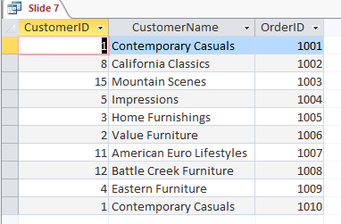
Result of Slide 7 and (or) Slide 8

Slide 10
Outer Join Example
Q2. List the customer name, ID number, and order number for all customers. Include customer information even for customers that do not have an order.
SELECT Customer_T.CustomerID, CustomerName, OrderID
FROM CUSTOMER_T LEFT OUTER JOIN ORDER_T ON Customer_T.CustomerID= Order_T.CustomerID;
LEFT OUTER JOIN clause causes customer data to appear even if there is no corresponding order data
Does it matter which table is on the left and which is on the right?

Slide 11
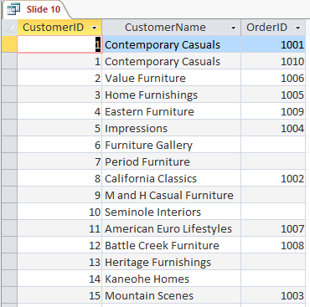
Comparison of INNER JOIN vs. OUTER JOIN
Result of Slide 7 (or 8)
Result of Slide 10

Slide 12
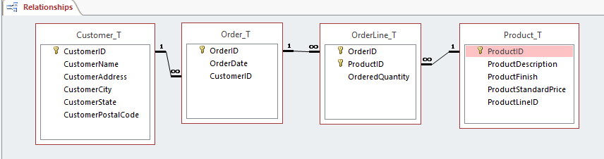
Multiple Table Join Example
Q3: Assemble all information necessary (such customer information, order details, and price) to create an invoice for OrderID 1006
Review ERD before designing the query

Slide 13
Multiple Table Join – Solution Q 3.1
SELECT Customer_T.CustomerID, CustomerName, CustomerAddress, CustomerCity, CustomerState, CustomerPostalCode, Order_T.OrderID, OrderDate, ProductDescription, OrderedQuantity, ProductStandardPrice, (OrderedQuantity*ProductStandardPrice)
FROM Customer_T, Order_T, OrderLine_T, Product_T
WHERE Order_T.CustomerID=Customer_T.CustomerID AND Order_T.OrderID=OrderLine_T.OrderID AND OrderLine_T.ProductID=Product_T.ProductID AND Order_T.OrderID=1006;
Use equi-join to join 4 tables
How many “=” conditions are needed to equi-join 4 tables (match primary key with foreign key)?

Slide 14
Multiple Table Join – Solution Q 3.2
SELECT Customer_T.CustomerID, CustomerName, CustomerAddress, CustomerCity, CustomerState, CustomerPostalCode, Order_T.OrderID, OrderDate, ProductDescription, OrderedQuantity, ProductStandardPrice, (OrderedQuantity*ProductStandardPrice) AS SubTotal
FROM PRODUCT_T INNER JOIN ((CUSTOMER_T INNER JOIN ORDER_T ON Customer_T.CustomerID = Order_T.CustomerID) INNER JOIN OrderLine_T ON Order_T.OrderID = OrderLine_T.OrderID) ON Product_T.ProductID = OrderLine_T.ProductID
WHERE Order_T.OrderID=1006;

Slide 15
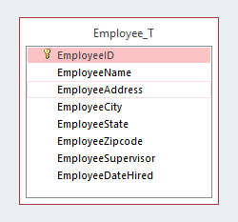
Self-Join Example
Q 4: Display the EmployeeID and EmployeeName of each employee, together with the name of the employee’s supervisor.
Review ERD before designing the query

Slide 16
Self-Join Example – Solution (Q4)
SELECT E.EmployeeID, E.EmployeeName, M.EmployeeName AS Manager
FROM Employee_T AS E, Employee_T AS M
WHERE E.EmployeeSupervisor=M.EmployeeID;
The same table is used on both sides of the join; distinguished using table aliases.
Self-joins are usually used on tables with unary relationships.

Slide 17
CHAPTER 6: ADVANCED SQL PART B SUBQUERY
Modern Database Management

Slide 18
Objectives
Write noncorrelated and correlated subqueries
Write UNION query
Understand triggers and stored procedures

Slide 19
Processing Multiple Tables Using Subqueries
Subquery – placing an inner query (SELECT statement) inside an outer query
Where a subquery can be placed:
In a condition of the WHERE clause
As a “table” of the FROM clause
Within the HAVING clause
Subqueries can be:
Noncorrelated–executed once for the entire outer query
Correlated–executed once for each row returned by the outer query

Slide 20
Subquery Example – Join vs. Subquery
Show the name and address information of the customer who placed order 1008?
Equi-join Solution
Subquery Solution
SELECT CustomerName, CustomerAddress, CustomerCity, CustomerState, CustomerPostalCode
FROM Customer_T, Order_T
WHERE Customer_T.CustomerID=Order_T.CustomerID AND OrderID=1008;
SELECT CustomerName, CustomerAddress, CustomerCity, CustomerState, CustomerPostalCode
FROM Customer_T
WHERE Customer_T.CustomerID=
(SELECT Order_T.CustomerID
FROM Order_T
WHERE OrderID=1008);

Slide 21
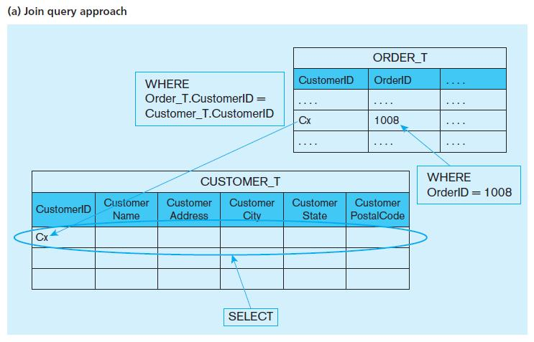
Graphical Depiction of Equi-Join

Slide 22
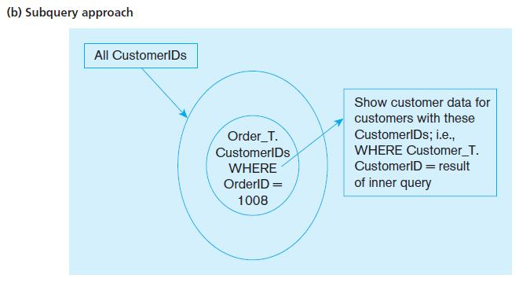
Graphical Depiction of Subquery

Slide 23
Correlated vs. Noncorrelated Subqueries
Noncorrelated subqueries:
Do not depend on data from the outer query
Execute once for the entire outer query
Correlated subqueries:
Make use of data from the outer query
Execute once for each row of the outer query
Can use the EXISTS operator

Slide 24
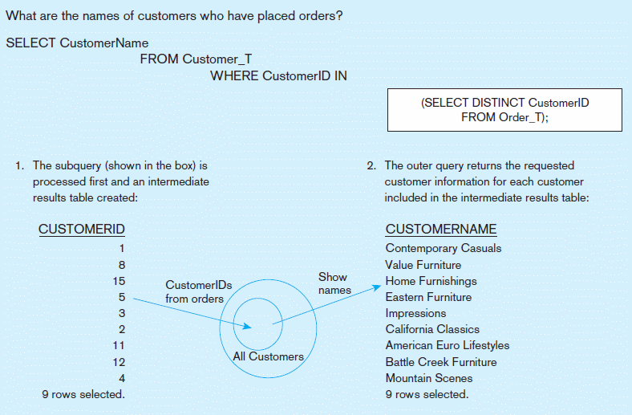
Figure 6-8a: Processing a noncorrelated subquery
Query: Show the names of those customers who placed orders.
A noncorrelated subquery processes completely before the outer query begins.

Slide 25
Correlated Subquery Example – 1
Query: Show the OrderID of those orders that include any furniture finished in “Natural ash”.
SELECT DISTINCT OrderID
FROM OrderLine_T
WHERE EXISTS
(SELECT * FROM Product_T
WHERE ProductID = OrderLine_T.ProductID
AND Productfinish = ‘Natural ash’);
The EXISTS operator will return a TRUE value if the subquery resulted in a non-empty set, otherwise it returns a FALSE
The subquery is testing for a value that comes from the outer query
A correlated subquery always refers to an attribute from a table referenced in the outer query

Slide 26
Correlated Subquery Example – 2
Query: Show the OrderID of those orders that include any furniture finished in “Natural ash”.
SELECT DISTINCT OrderID
FROM OrderLine_T
WHERE ProductID IN
(SELECT ProductID FROM Product_T
WHERE Productfinish = ‘Natural ash’);
🡺 A noncorrelated subqueries does not depend on data from the outer query.

Slide 27
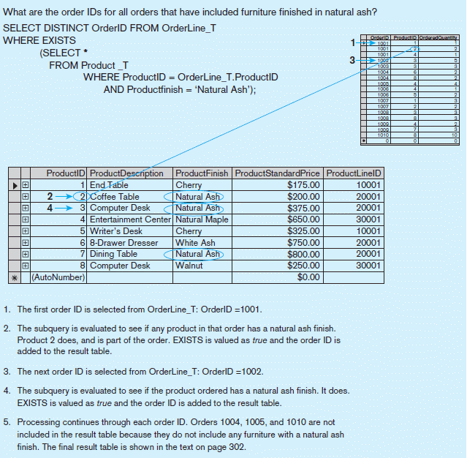
Figure 6-8b Processing a correlated subquery
Subquery refers to outer-query data, so executes once for each row of outer query
Note: only the orders that involve products with Natural Ash will be included in the final results

Slide 28
Show all products whose standard price is higher than the average price – 1 (using derived table)
One column of the subquery is an aggregate function that has an alias name. That alias can then be referred to in the outer query
Subquery forms the derived table used in the FROM clause of the outer query
SELECT ProductDescription, ProductStandardPrice, AvgPrice
FROM Product_T, (SELECT AVG(ProductStandardPrice) AS AvgPrice
FROM Product_T)
WHERE ProductStandardPrice>AvgPrice;
The WHERE clause normally cannot include aggregate functions. But because the aggregate is performed in the subquery, its result can be used in the outer query’s WHERE clause

Slide 29
Show all products whose standard price is higher than the average price – 2 (option 2)
SELECT ProductDescription, ProductStandardPrice
FROM Product_T
WHERE ProductStandardPrice > (SELECT AVG(ProductStandardPrice) AS AvgPrice
FROM Product_T);

Slide 30
Combing Queries - Union
SELECT C1.CustomerID, CustomerName, OrderedQuantity, 'Largest Quantity' AS Quantity
FROM Customer_T C1,Order_T O1, OrderLine_T Q1
WHERE C1.CustomerID = O1.CustomerID
AND O1.OrderID = Q1.OrderID
AND OrderedQuantity =
(SELECT MAX(OrderedQuantity)
FROM OrderLine_T)
UNION
SELECT C1.CustomerID, CustomerName, OrderedQuantity, 'Smallest Quantity'
FROM Customer_T C1, Order_T O1, OrderLine_T Q1
WHERE C1.CustomerID = O1.CustomerID
AND O1.OrderID = Q1.OrderID
AND OrderedQuantity =
(SELECT MIN(OrderedQuantity)
FROM OrderLine_T)
ORDER BY 3;

Slide 31
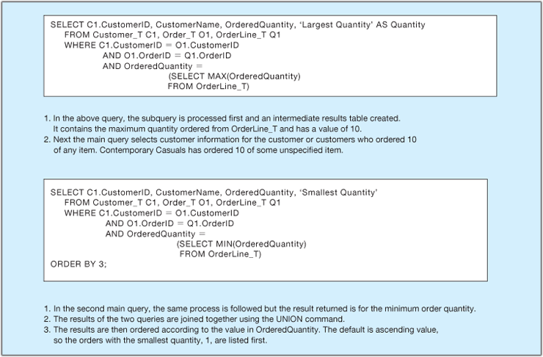
Combing Queries – Union (Explanation)

Slide 32
Tips for Developing Queries
Review ERD; be familiar with the data model (entities and relationships)
Understand the desired results
Know the attributes desired in result
Identify the entities that contain desired attributes
Construct a WHERE equality for each link
Fine tune with GROUP BY and HAVING clauses if needed
Consider the effect on unusual data

Slide 33
Query Efficiency Considerations
Instead of SELECT *, identify the specific attributes in the SELECT clause; this helps reduce network traffic of result set
Limit the number of subqueries; try to make everything done in a single query if possible
If data is to be used many times, make a separate query and store its results rather than performing the query repeatedly

Slide 34
Triggers and Routines
Routines
Program modules that execute on demand
Functions – routines that return values and take input parameters
Procedures – routines that do not return values and can take input or output parameters
Triggers – routines that execute in response to a database event (INSERT, UPDATE, or DELETE)

Slide 35
Triggers and Routines
Routines – Program modules that execute on demand (do not run automatically)
Routines have been developed to address shortcomings of SQL as an application development language
Routines must be explicitly called
Functions – Routines that return values and take input parameters
Procedures – Routines that do not return values and can take input or output parameters
Triggers – Program modules that are considered (triggered) when a data modification (i.e., INSERT, UPDATE, DELETE) occurs or if certain data definitions are encountered (can run automatically when the trigger events occur)
Can be used to prevent unauthorized changes to the database
Can also be used to evaluate changes and take actions based on the nature of the changes

Slide 36
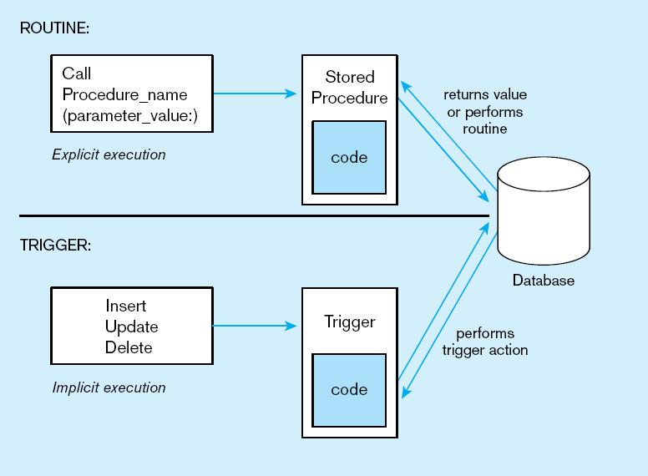
Figure 6-12: Routines vs. Triggers
Procedures are called explicitly
Triggers are event-driven
Source: adapted from Mullins, 1995.

Slide 37
An Example of Triggers
CREATE TRIGGER StandardPriceUpdate
AFTER UPDATE OF ProductStandardPrice ON Product_T
FOR EACH ROW
INSERT INTO PriceUpdates_T VALUES (ProductDescription, SYSDATE, ProductStandardPrice);

